Slide 1
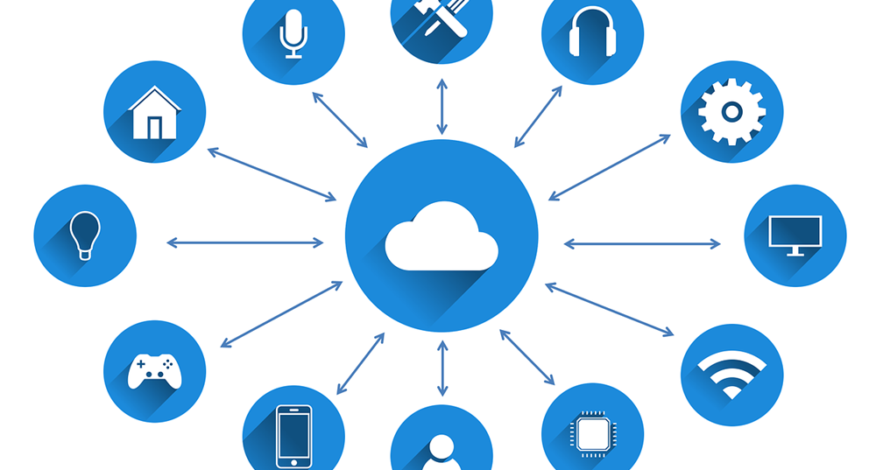
.
Why we took IOT ?

Slide 2
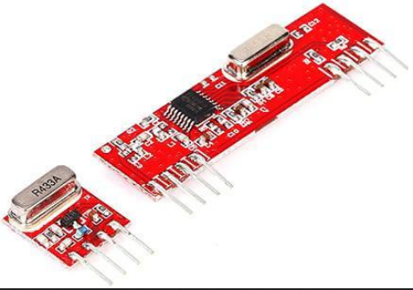
WE HAVE…………
RF TRX AND REX

Slide 3
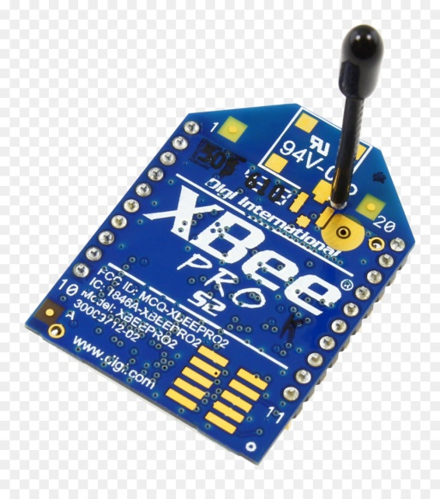
WE HAVE…………
X-BEE TRX AND REX

Slide 4
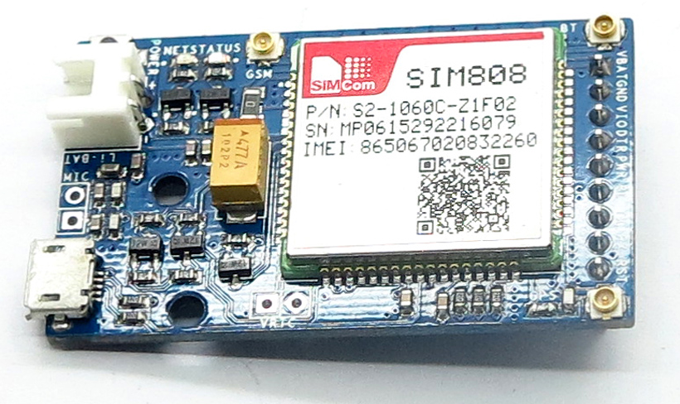
WE HAVE…………
DTMF
GPS and GSM

Slide 5
We are using……..
IOT

Slide 6
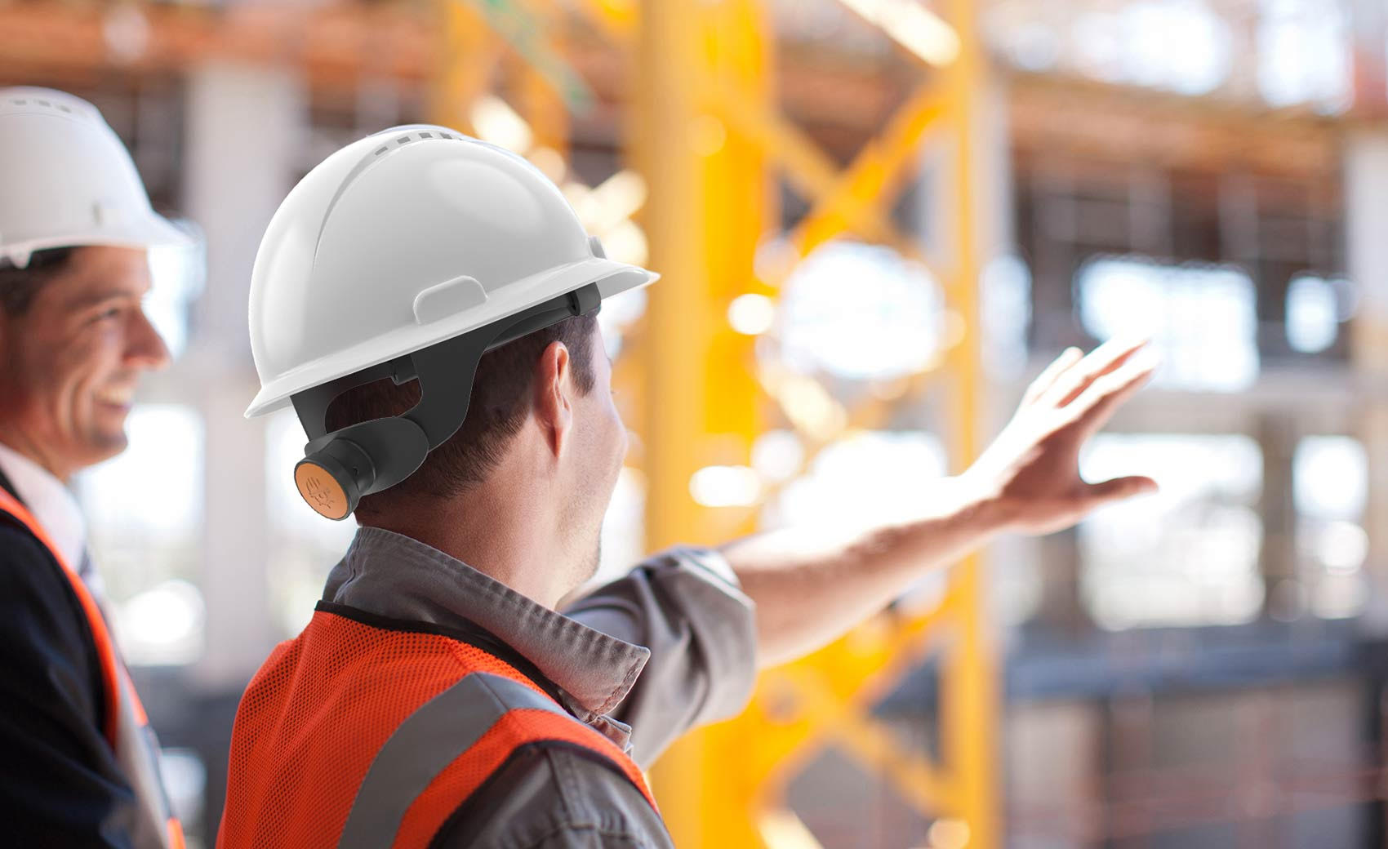
IOT BASED SAFETY MINNING HELMAT
GUID TEACHER
P.SHAMBABU SIR

Slide 7
BATCH - V
BH.P.K.RAJU -17404730
K. VENKATA SATYA SAI NAGENDRA – 17404738
P. NAVEEN - 17404748
P. JAGADHISH VARMA - 17404748
P. DHANISTA KASI SAI SANTHOSHA ANUDEEP
- 17404750

Slide 8
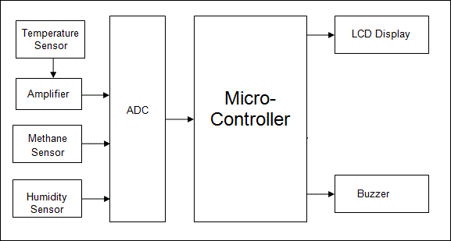
Block diagram:
IOT
WEB PAGE
..

Slide 9
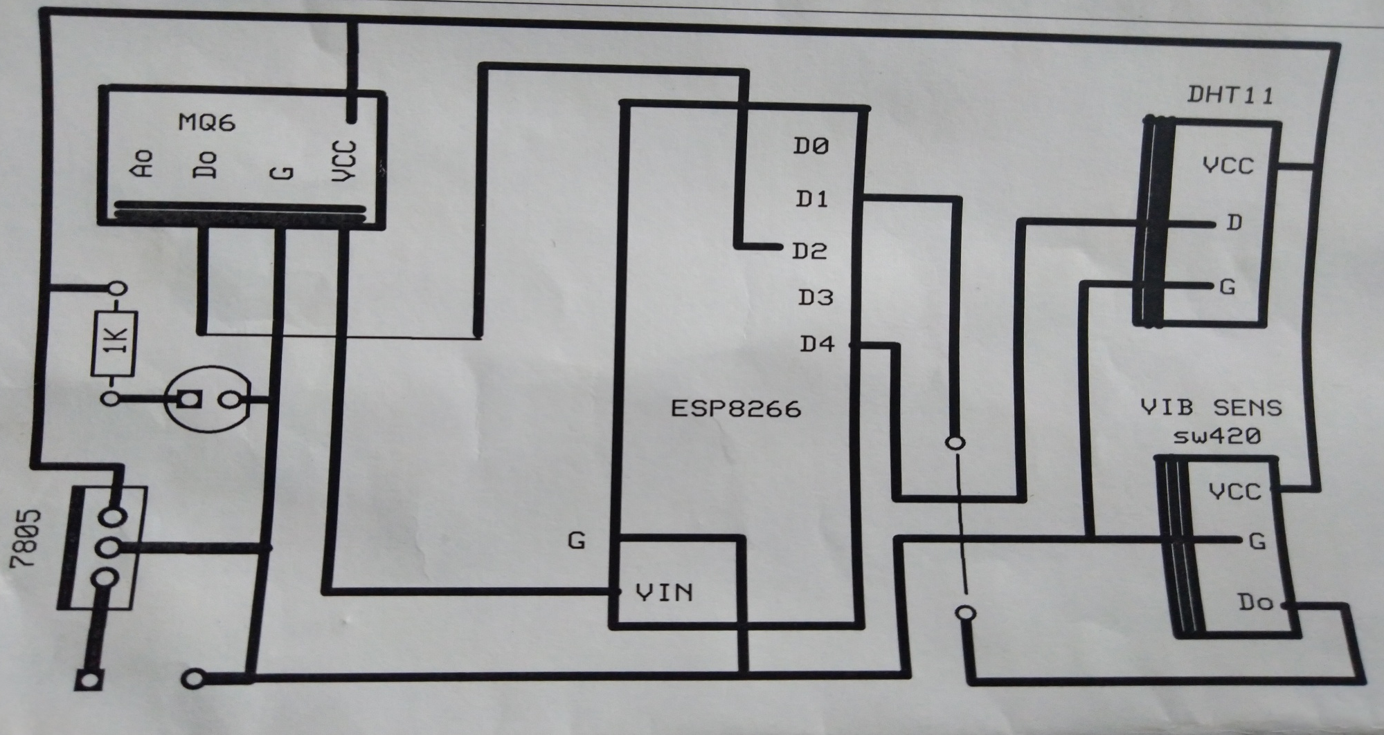
Layout diagram :

Slide 10
Sensors:
MQ-5 gas sensor applies SnO2 which has a lower conductivity in the clear air as a gas-sensing material. the conductivity of the gas sensor raises along with the inflammable gas concentration increases. MQ-5 plays a high performance in detecting butane, propane and methane, and can identify both propane and methane at a same time. MQ-5 is highly sensitive to natural gas. It features with the ability to detect various inflammable gases

Slide 11
Vibration sensor:
The Vibration module based on the vibration sensor SW-420 to detect if there is any vibration that beyond the threshold. The threshold can be adjusted by the on-board potentiometer.
When this no vibration, this module output logic LOW the signal indicate LED light , And vice versa.

Slide 12
Temperature and humidity sensor:
temperature and humidity sensor uses a thermistor to measure the surrounding air, and spits out a digital signal on the data pin. Its fairly simple to use, but requires careful timing to grab data

Slide 13
-
APPLICATIONS:

Slide 14
advantages:
Saves many life’s
Low cost
Easy to install
Easy to operate
No man power is required
Automated work

Slide 15
Conclusion :
An IOT system consists of sensors/devices which “talk” to the cloud through some kind of connectivity. Once the data gets to the cloud, software processes it and then might decide to perform an action, such as sending an alert or automatically adjusting the sensors/devices without the need for the user.
In this project we are using IOT to transfer the condition of worker to the control room and to rescue teams

Slide 16
Thank you
…………………………………ANY DOUBTS

